Slide 1



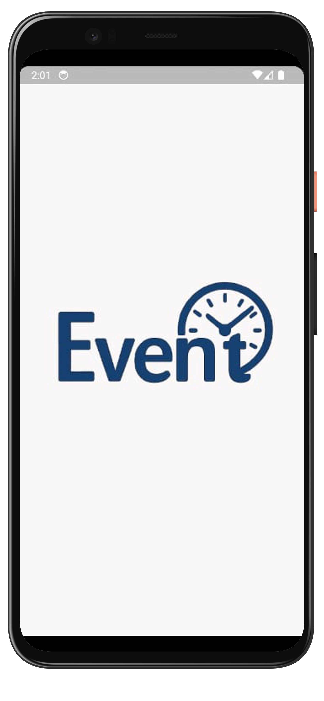
•
Event Countdown App.
Tech Brand Kit

Slide 2

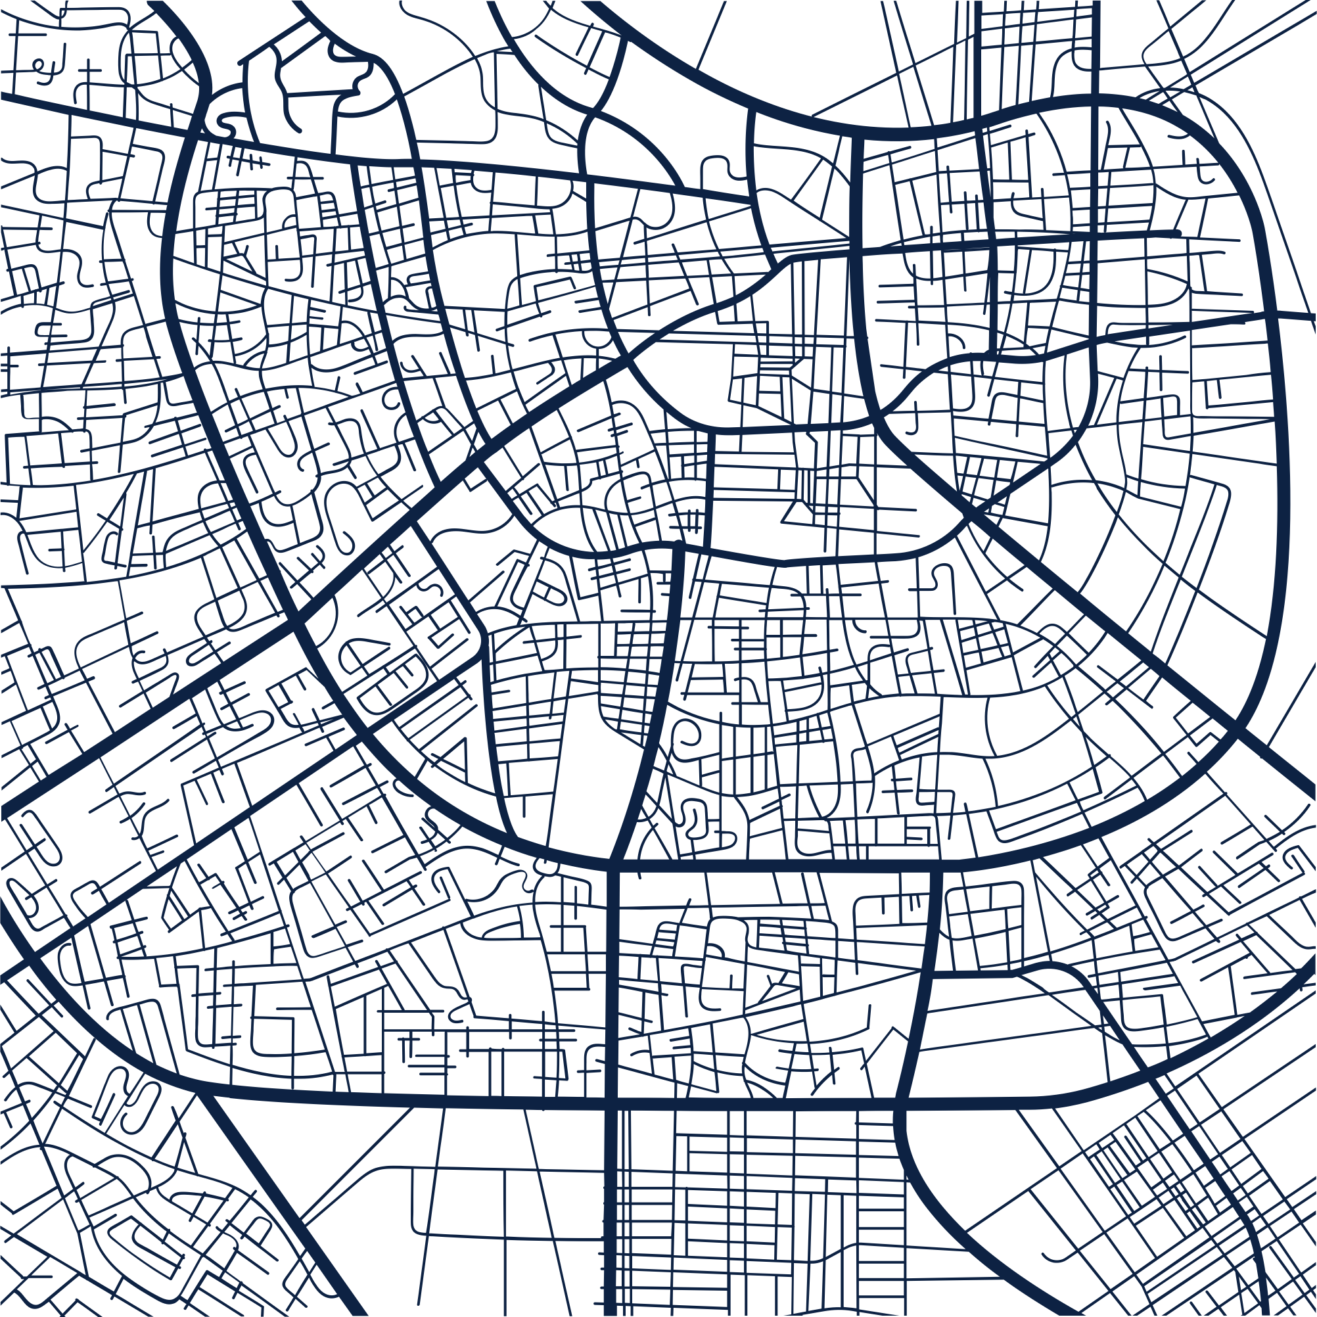
Mobile App for Tracking Important Events
•
📱 Event Countdown
Why This App?
What It Does
Managing your events has never been easier. Event Countdown is a simple and intuitive mobile application that helps users track upcoming events, view countdowns, and get timely reminders so they never miss an important moment
People often forget birthdays, deadlines, or important dates.
Traditional calendars are cluttered or lack focused countdowns.
Users need a quick and visual way to track time until an event.
Lets users create events with title and date/time.
Automatically displays countdowns in real-time.
Sends notifications when the event is due.
Allows event search and filtering for easy navigation

Slide 3
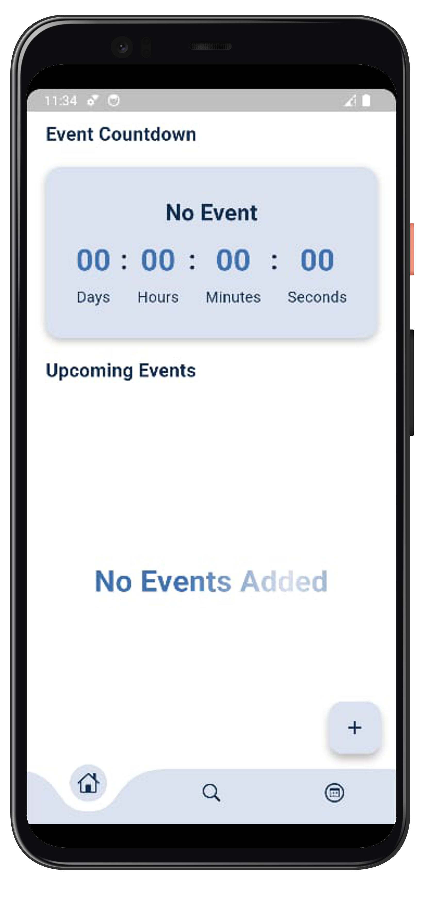
•
•
Home Screen
Shows the list of events with countdown timers.
Clean interface showing event title, date, and time remaining.
Go to page

Slide 4
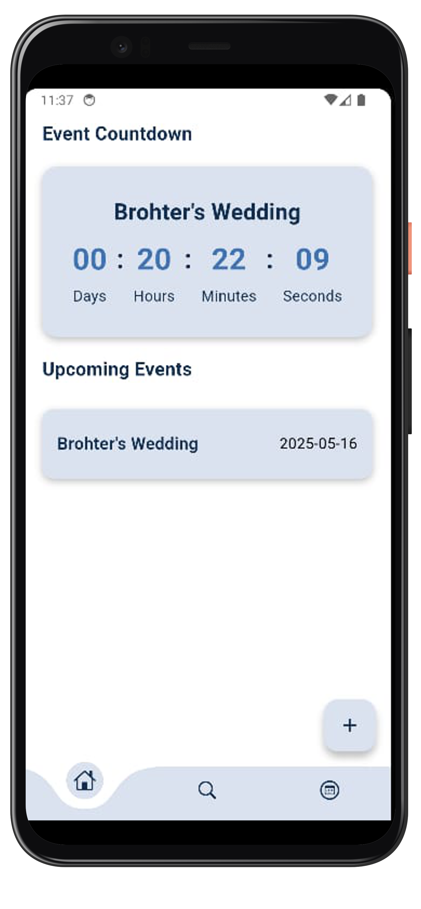
•
•
Countdown Detail View
Detailed countdown (e.g., days, hours, minutes)
Go to page

Slide 5
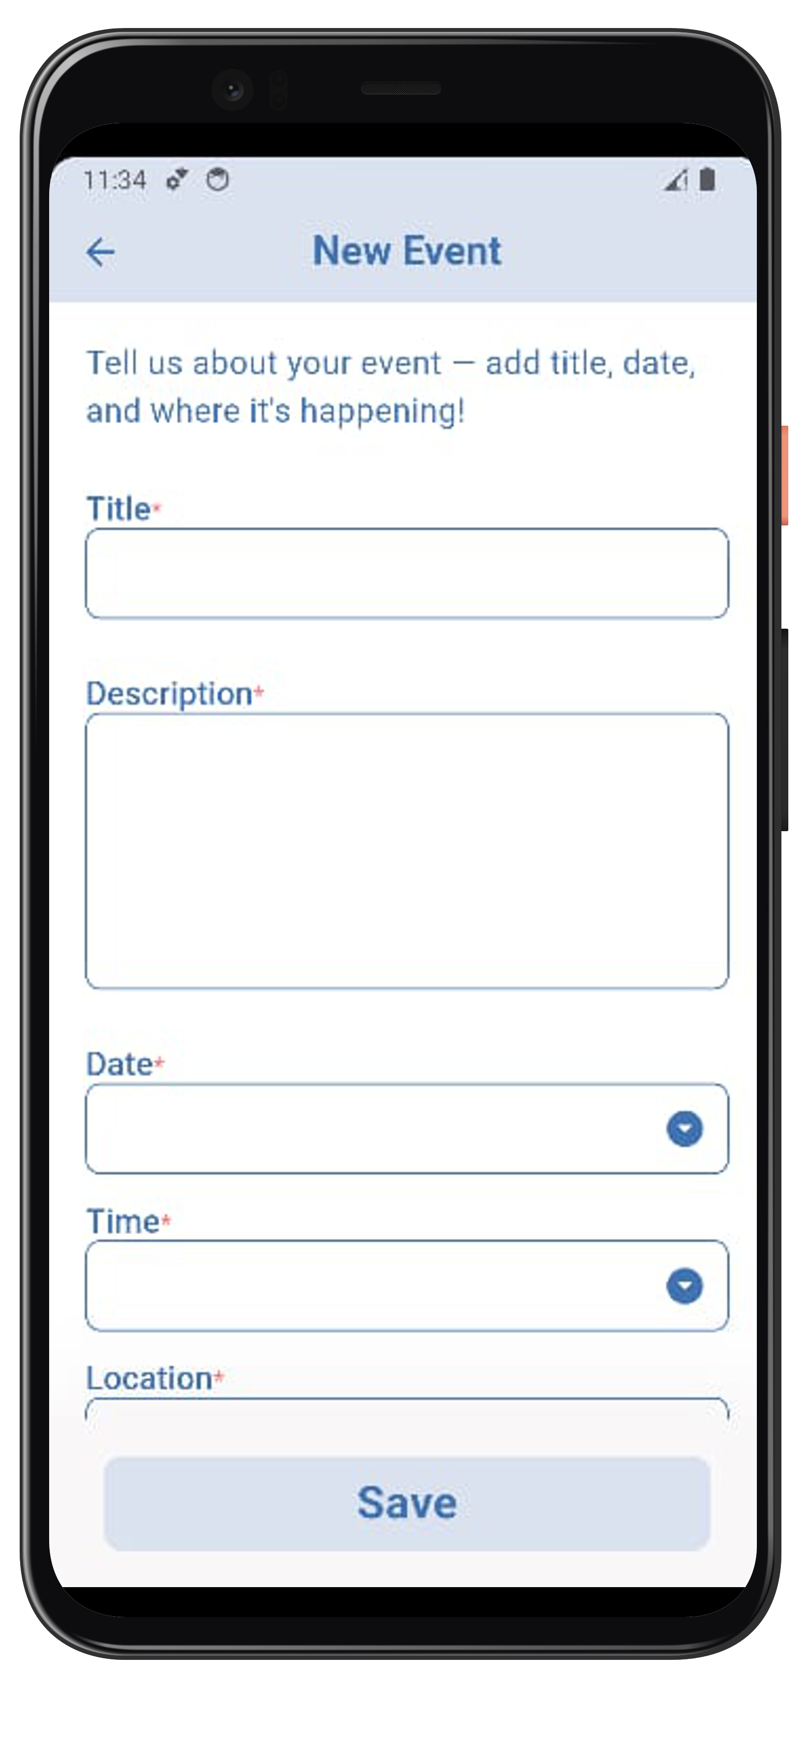
•
•
New Event Screen
Users can input event title, date, time, location and description.
“Save” button to add the event to the list
Go to page

Slide 6
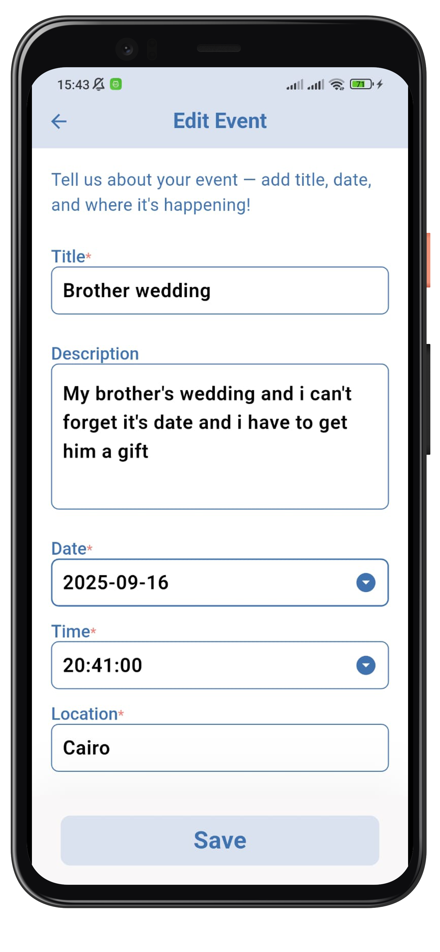
•
•
Edit Event Screen
This screen allows users to modify event details such as the event name, date, and city. It's useful when an event is rescheduled or information needs to be corrected.

Slide 7
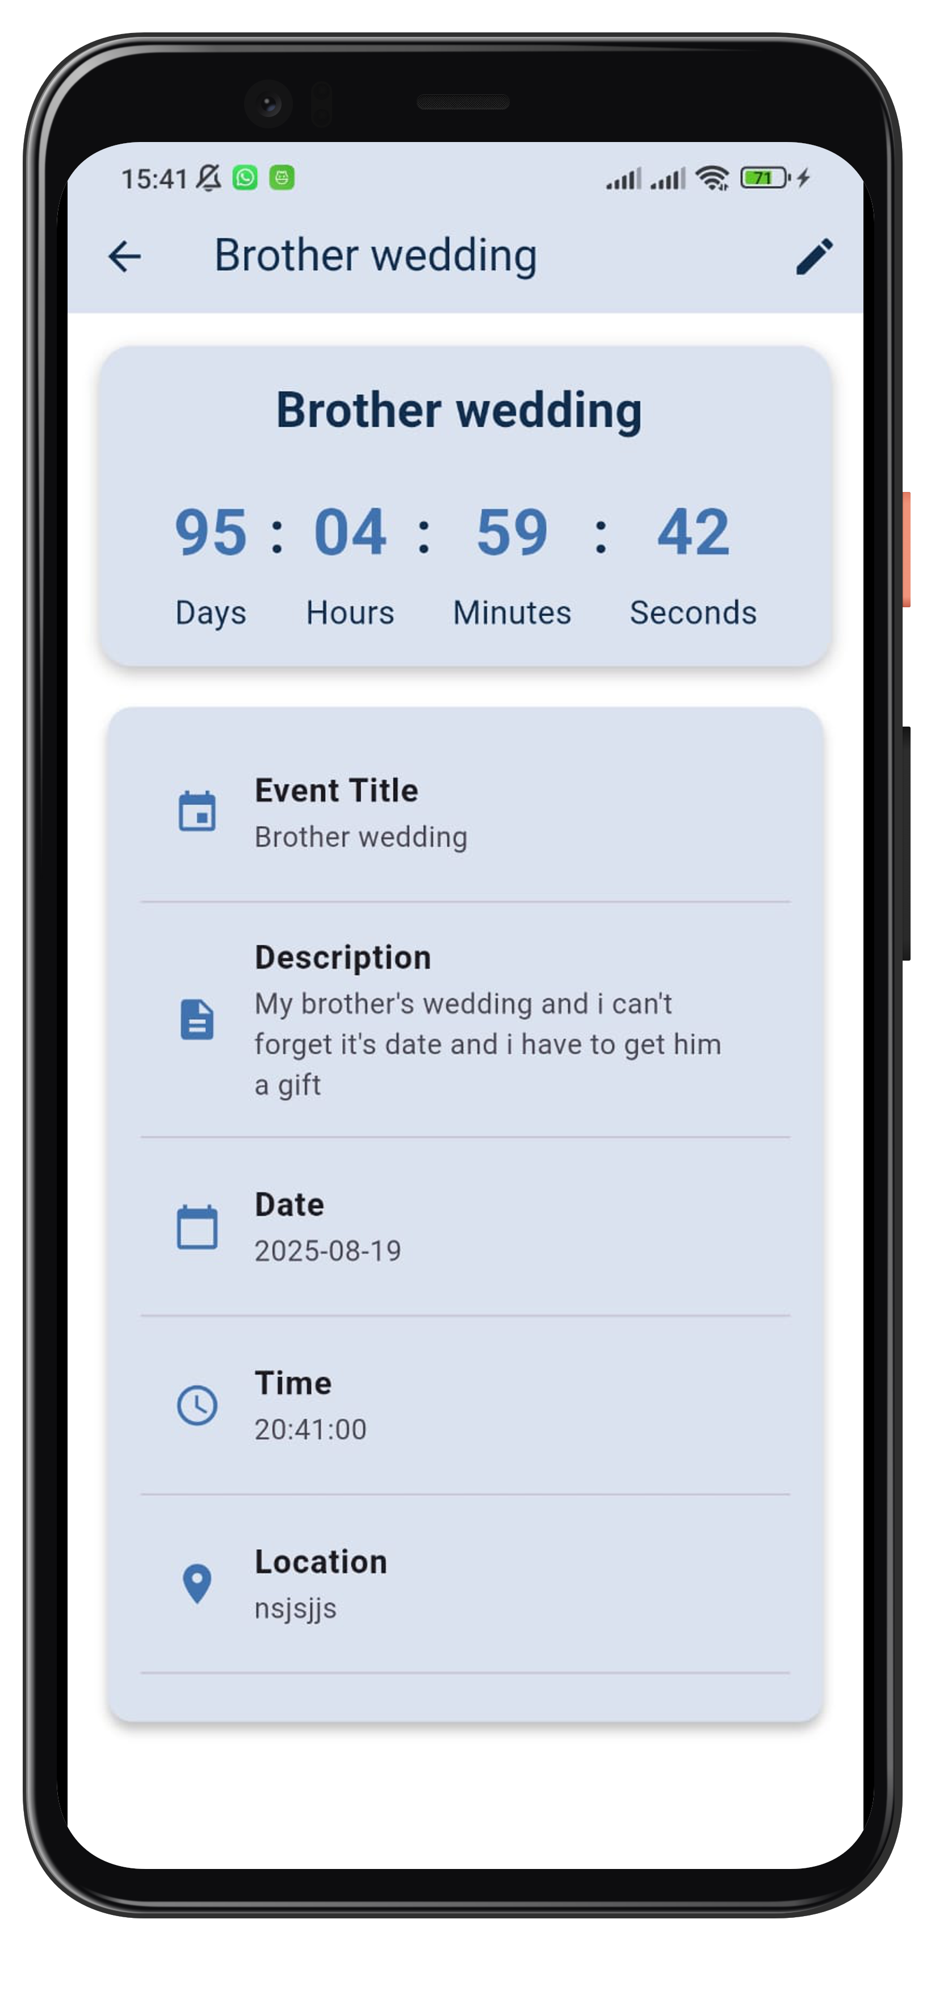
•
•
View Event Details
This screen allows users to display event details such as the event name, date, and city.
Go to page

Slide 8
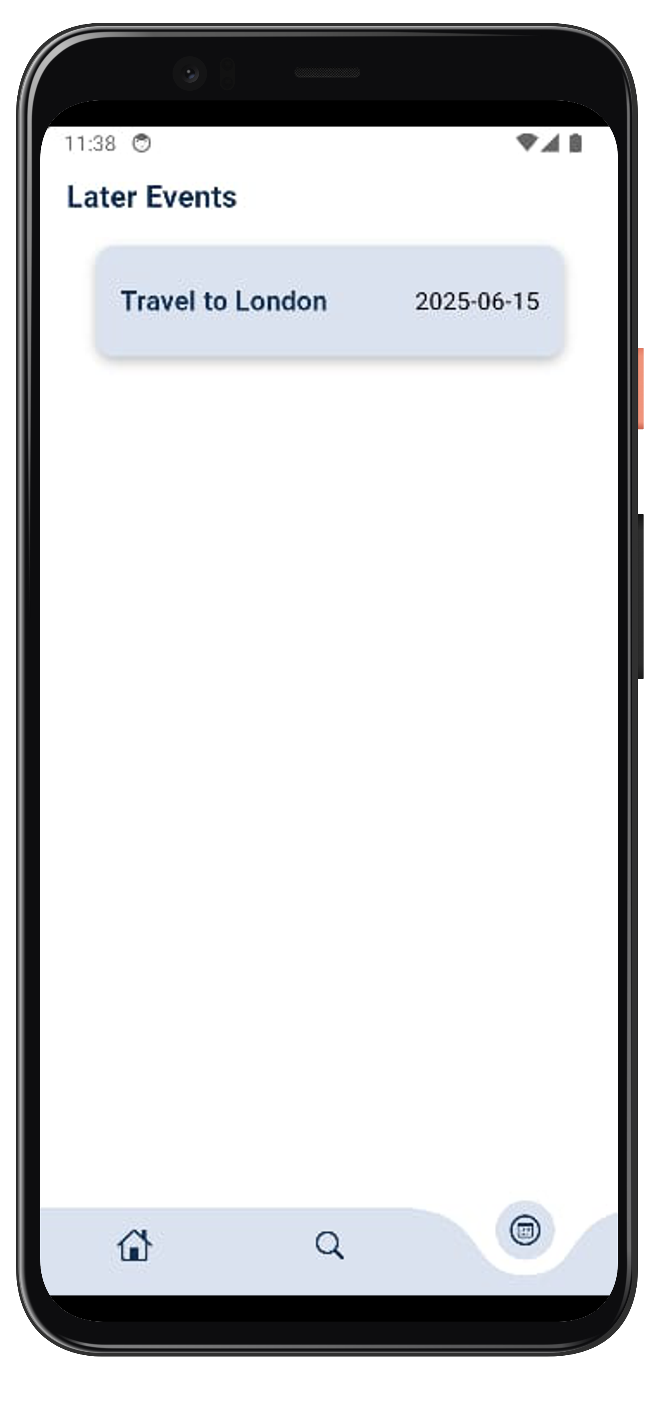
•
•
Later Events Screen
A separate screen to filter and show only events more than 10 days away.
Go to page

Slide 9
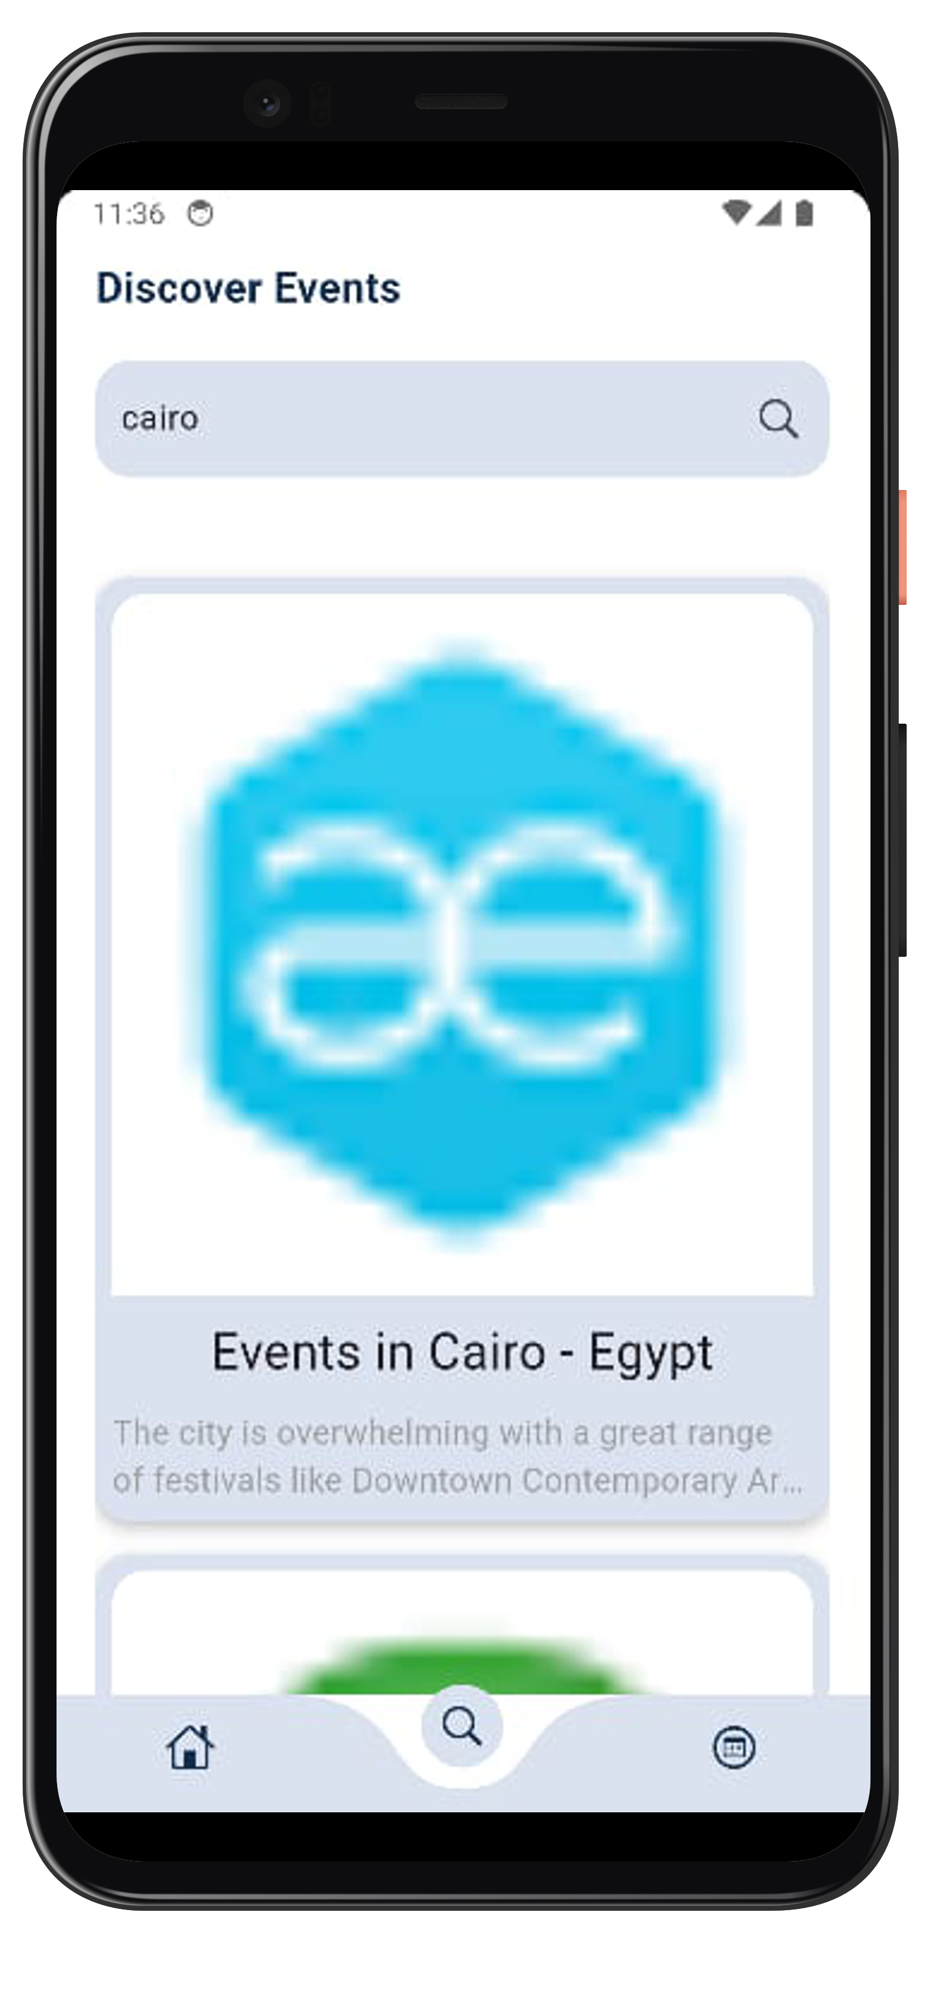
•
•
Discover Screen
Allows users to search for events by name or city
Ex:
A user in Cairo wants to find events happening in Cairo — they simply type "Cairo" and the list filters automatically.
Go to page

Slide 10
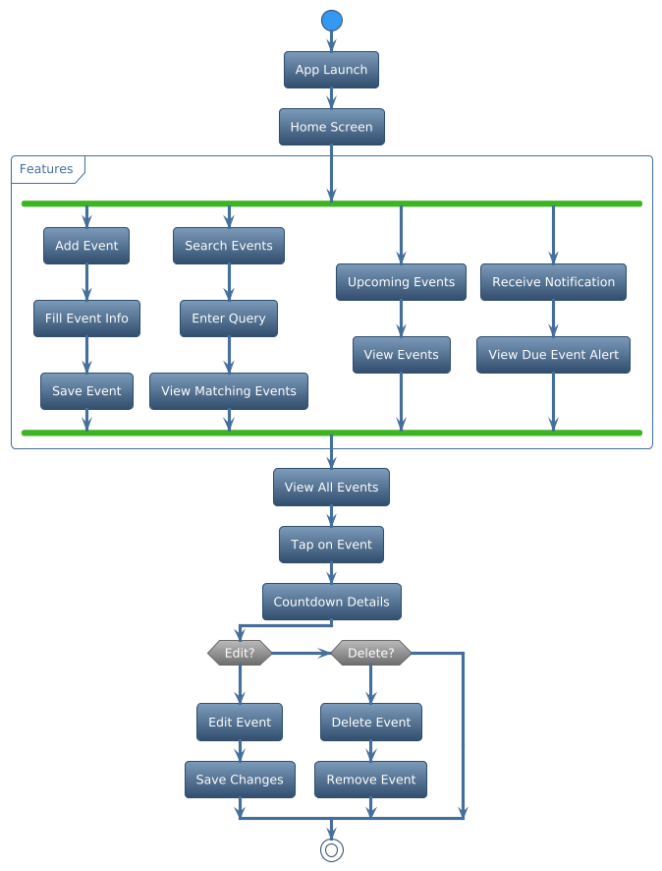
User Flow Diagram
•
.

Slide 11
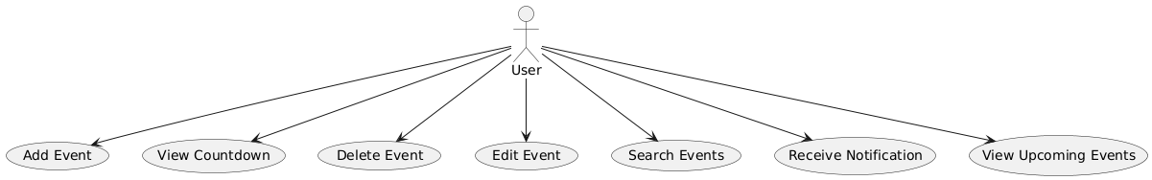
Use Case Diagram
•
.

Slide 12
User Stories
•
1.
As a user, I want to add an event so that I can track upcoming occasions..
1.
As a user, I want to add an event so that I can track upcoming occasions..
2.
As a user, I want to search for events by name or city so that I can quickly locate them.
3.
As a user, I want to view countdowns so that I know how much time is left.
4.
As a user, I want to view upcoming events that are more than 10 days away for better planning.
5.
As a user, I want to edit an event in case the date or details change.
6.
As a user, I want to delete an event to keep my list organized
7.
As a user, I want to receive notifications so I don’t miss important events

Slide 13
Business Case
•
Event Count Down App is a lightweight mobile application designed to help users track important events with real-time countdowns and timely notifications. The app addresses the common problem of forgetting personal or professional dates by offering an intuitive and fast solution.
Problem: Users lack a simple tool to visually track upcoming events.
Solution: Mobile app with countdowns, search by city, and get notifications.
Target Users: Students, professionals, and general users.
Benefits: Improved time management, clean UI, offline functionality.
Risks: Notification delays, device compatibility — mitigated with testing and reliable tools.
Timeline: ~6–10 weeks from planning to launch

Slide 14
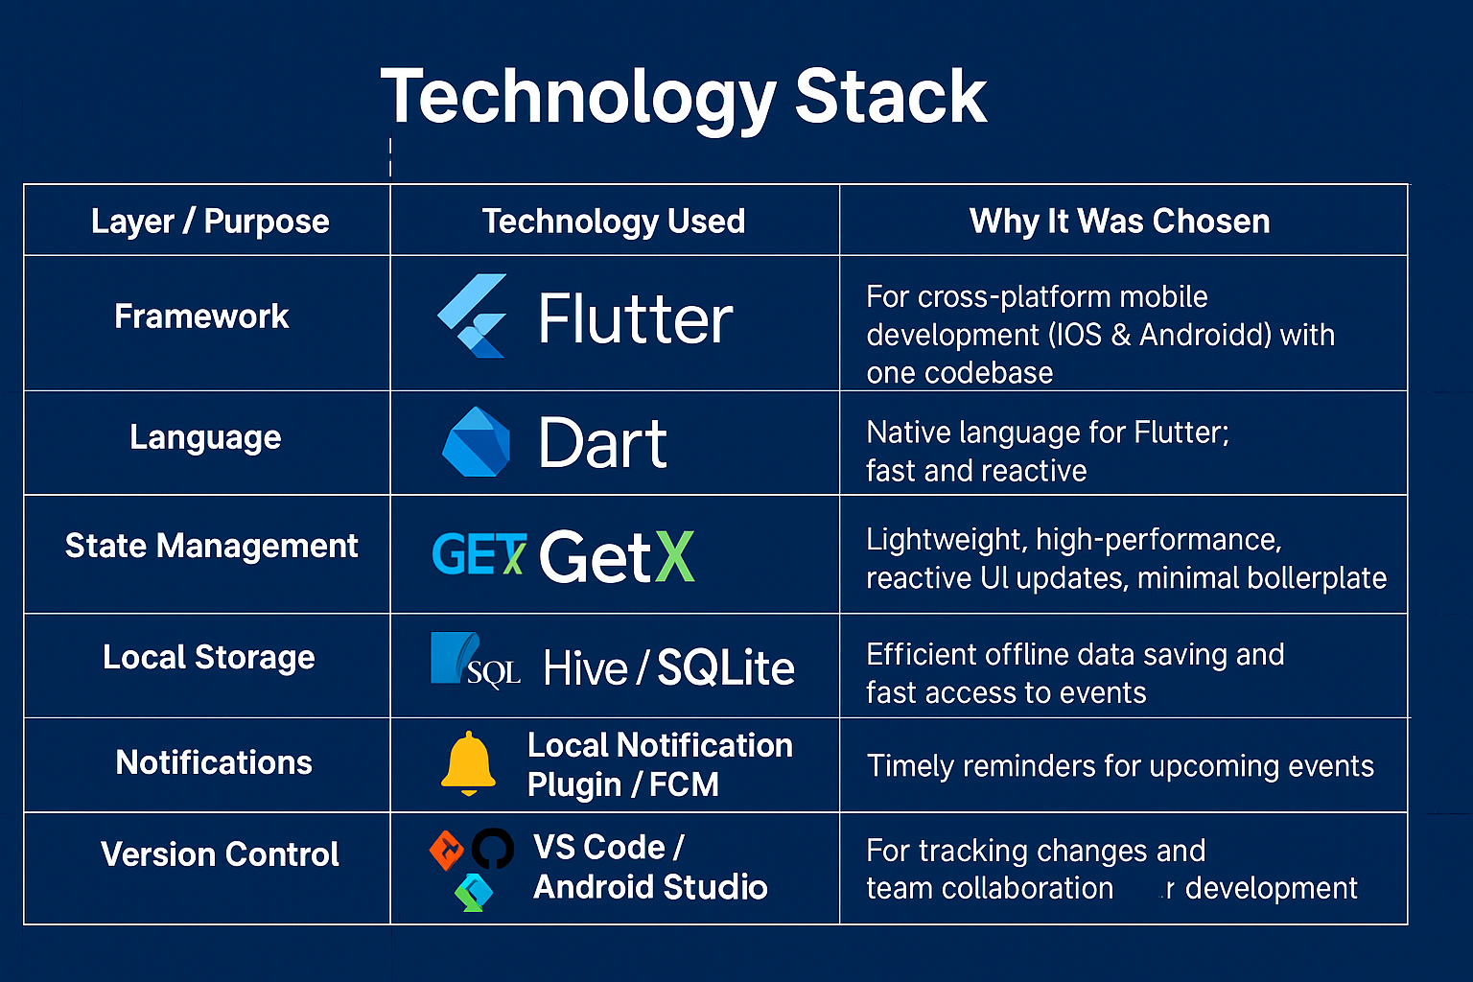

Slide 15
•
Our team
.
Moamen Yasser
Moustafa Tayseer
Noureddine Mohamed
Yousif Ahmed
Mahmoud Sarwat

Slide 16

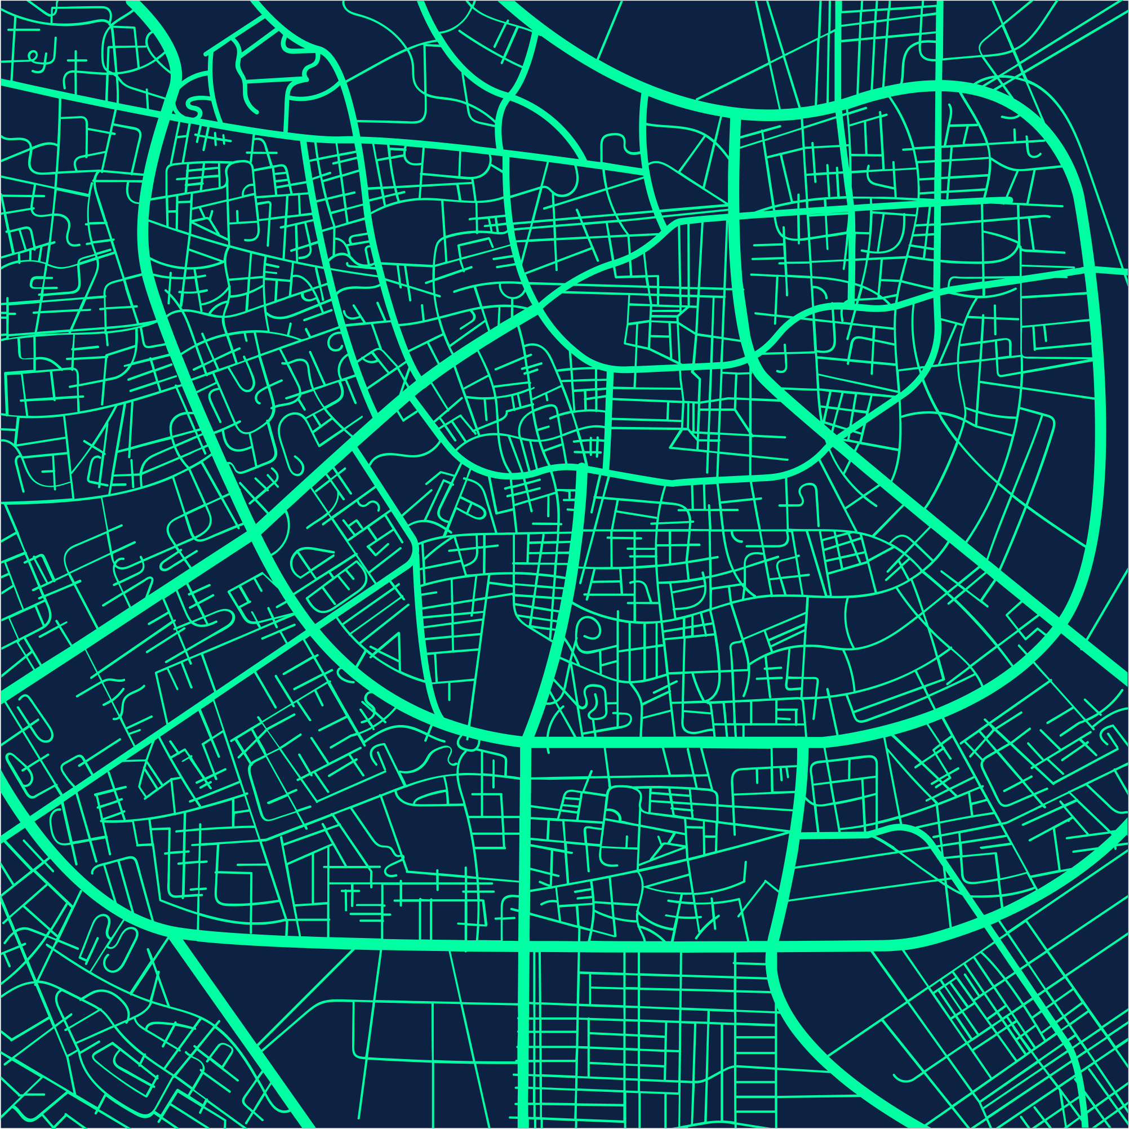
•
Thanks

